Slide 1





Pests in Indoor Environments –
Itchy and non-Itchy
Shujuan (Lucy) Li
University of Arizona
Maricopa Agricultural Center
Shujuan (Lucy) Li
University of Arizona
Maricopa Ag. Center
Email: lucyli@email.arizona.edu

Slide 2
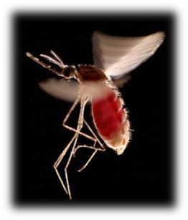
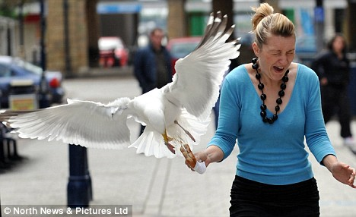
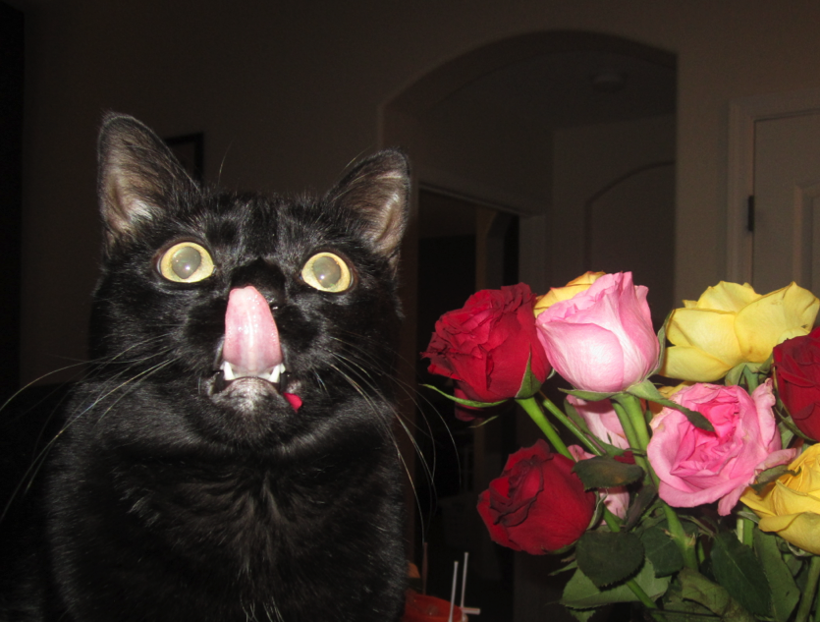
What is a pest?
A pest can be a:
  Plant (weed)
  Vertebrate (bird, rodent, or other mammals)
  Invertebrate (insect, tick, mite, or snail)
  Nematode
  Pathogen (bacteria, virus, or fungus)
  Other unwanted organism
Notes:
Pests are organisms that damage or interfere with desirable plants in our fields and orchards, landscapes, or wildlands, or damage homes or other structures. Pests also include organisms that impact human or animal health. Pests may transmit disease or may be just a nuisance. A pest can be a plant (weed), vertebrate (bird, rodent, or other mammal), invertebrate (insect, tick, mite, or snail), nematode, pathogen (bacteria, virus, or fungus) that causes disease, or other unwanted organism that may harm water quality, animal life, or other parts of the ecosystem.

Slide 3
Pests cause problems
Bite / sting
Damage food by entering and feeding
Contaminate food and surfaces with microorganisms they carry
A nuisance when they invade buildings
Cause allergies, asthma and other hypersensitive reactions
Vector disease microbes
Cause structural damage
Cause plant damage

Slide 4
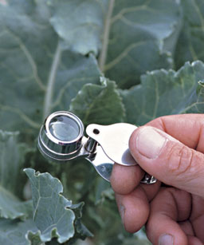
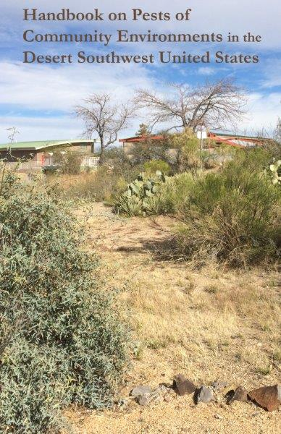
Identification is Critical!
All stages of a pest may not look the same or cause the same damage
Know the host of the pest or where it was found
Use good resources
Have pests examined by specialists
Handle samples carefully

Slide 5
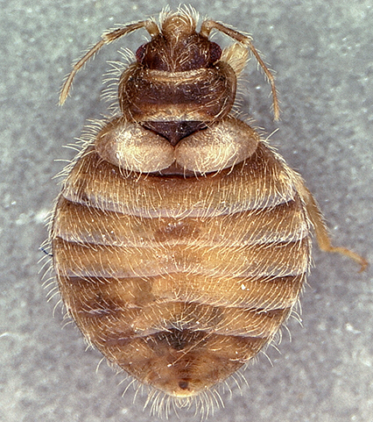
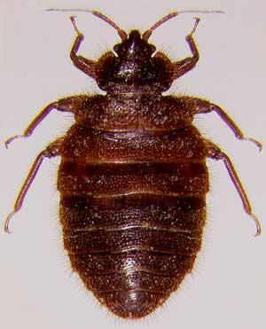
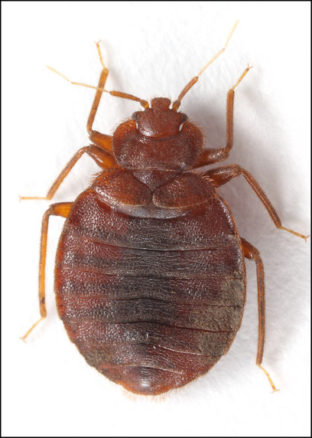
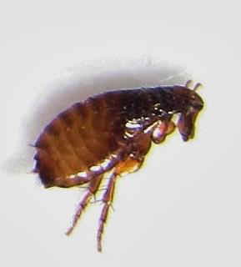

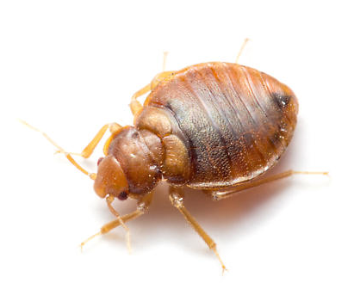

Slide 6
Swallow bug
Bat bug
Bed bug
Apple seed
Chimney swift bug
Cat flea

Slide 7

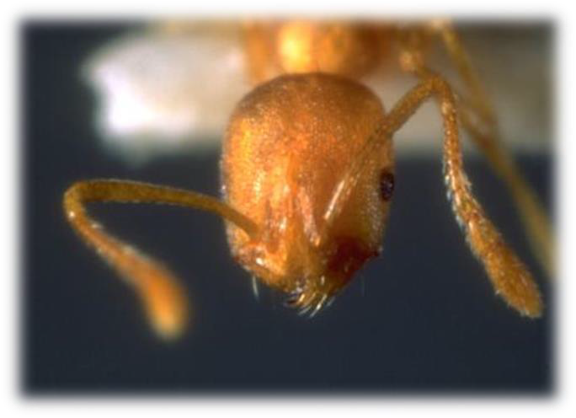
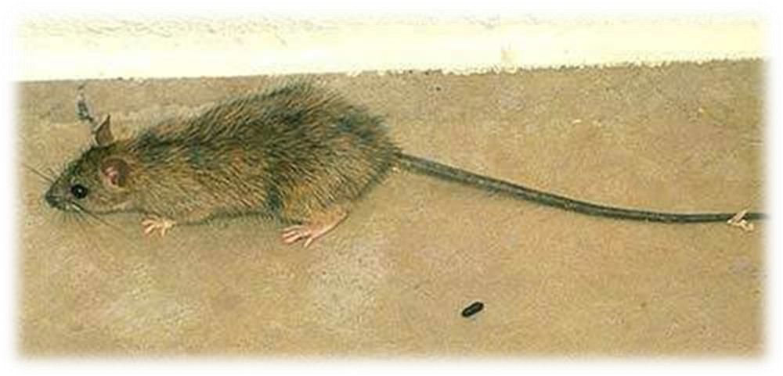
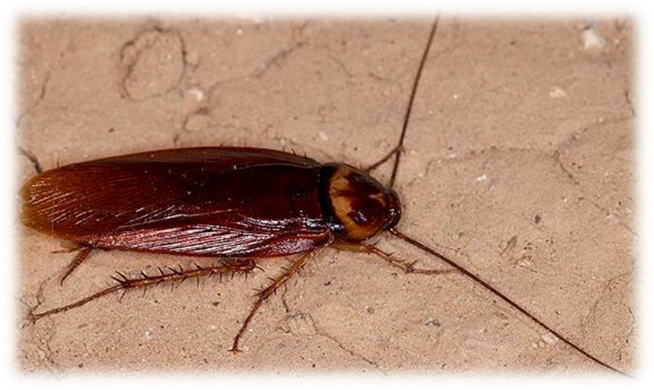
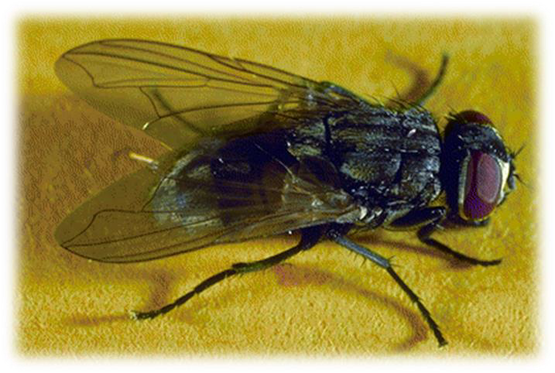
The Incredibles

Slide 8
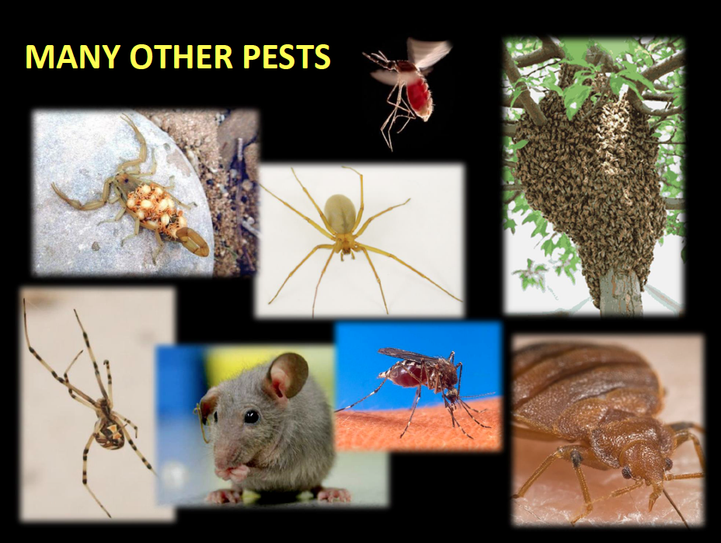
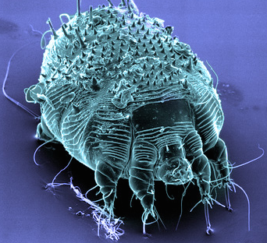
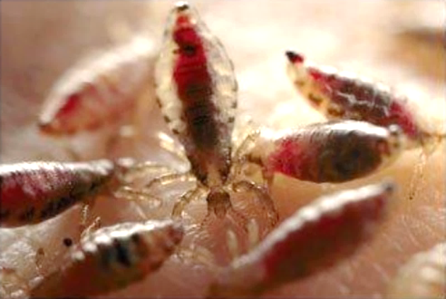

Slide 9
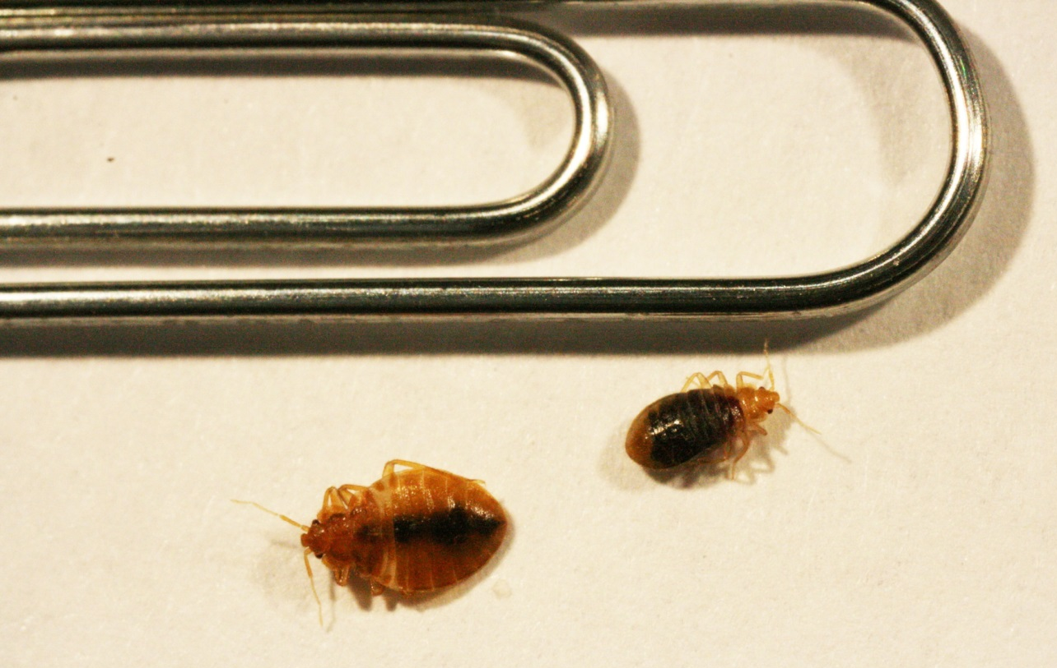
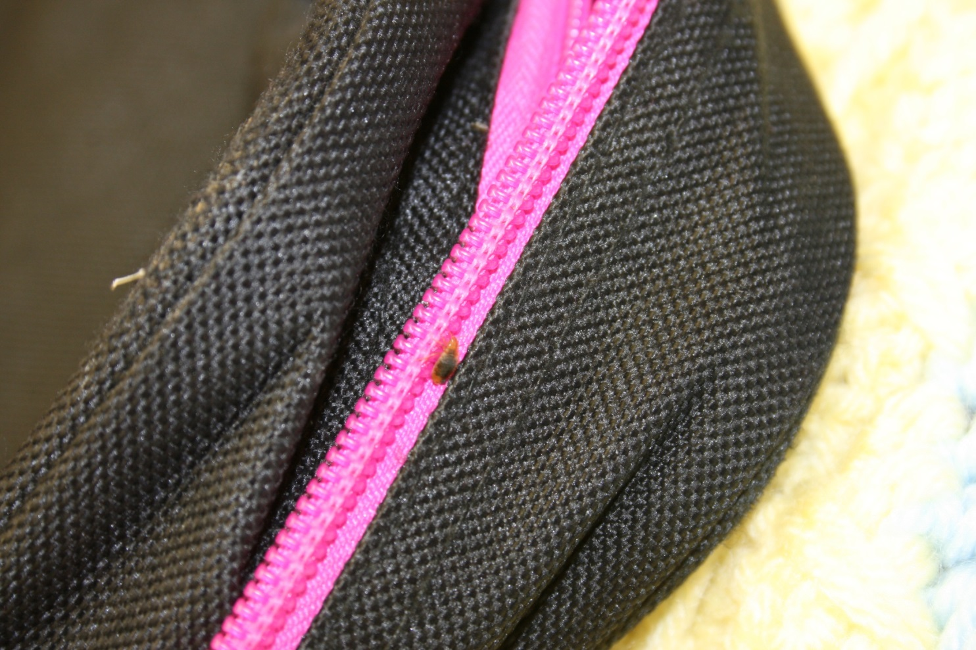
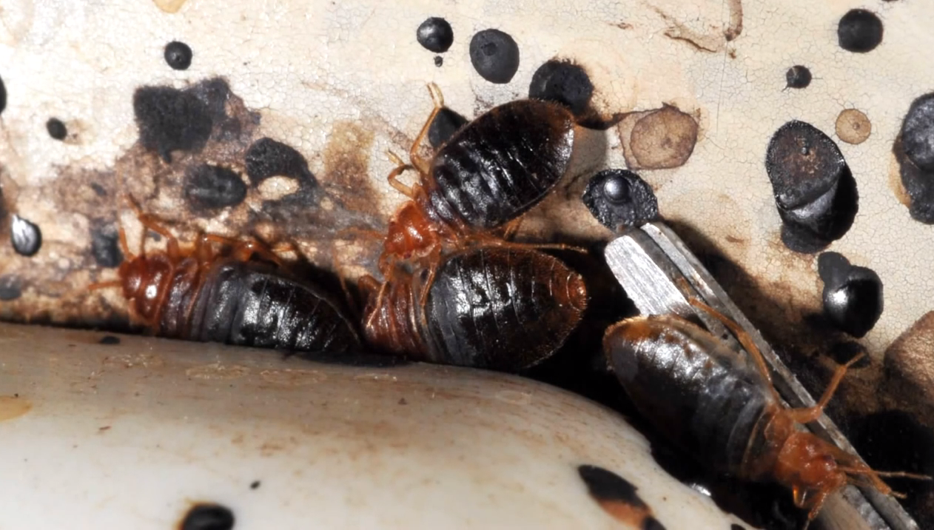
Panic pest number 1

Slide 10

Why bed bugs in school?
Bed bugs are excellent hitchhikers
  Clothing
  Backpacks
  Books
Bed bugs are good runners

Slide 11
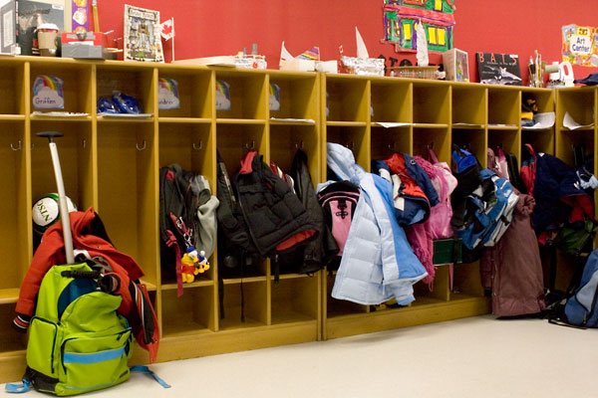
Schools are NOT good transition zones for bed bugs. It can happen, but is highly unlikely.
Notes:
Schools usually lack a food source at night.
Boarding schools are the exception.
Backpacks, books, clothing, wheelchairs from home provide harborage and transport.
can occur, but is unlikely unless……..e.g., students exchange clothes, clothing and back-packs are piled together, etc

Slide 12
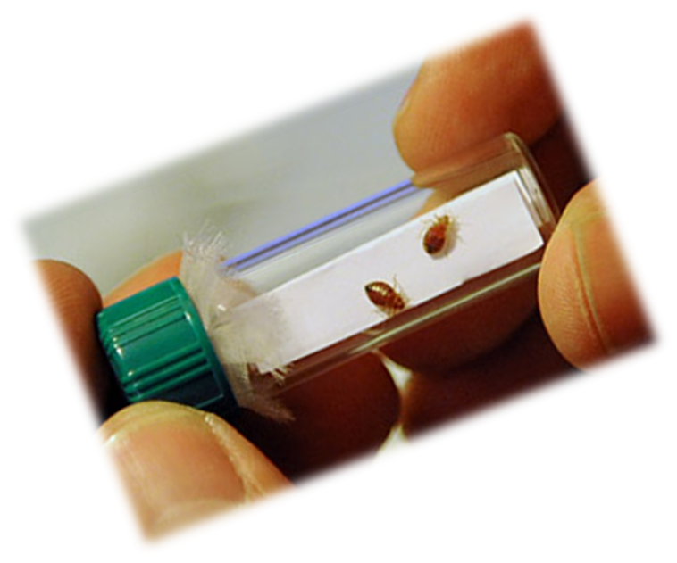
Notify all parents of kids in the room.
Provide basic information.
Inspect room, monitor, careful cleaning and vacuuming.
Reduce clutter.
Isolate student
belongings in clear
plastic bags.
Usually no need for
residual insecticides.
Notes:
Take a piece of scotch tape and tape the bed bug between tape layers. Save for proper identification.

Slide 13
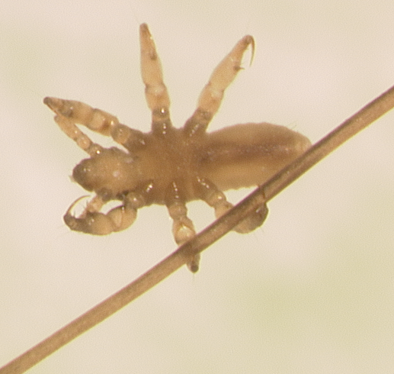
Panic pest number 2

Slide 14
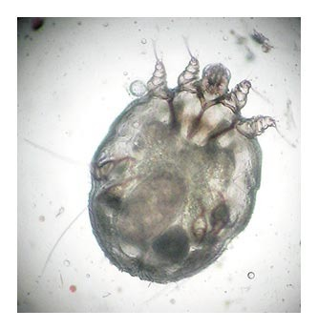
Itchy “bugs”
– Top 14
Bacterial conjunctivitis
Pertussis
Meningococcal meningitis
Hand, foot and mouth
Chickenpox
Measles
Mumps
Fifth disease
“Flu” Influenza
“Stomach flu” Norovirus
Scabies
Ringworm
Clostridium difficile
Methicillin-resistant Staphylococcus aureus (MRSA)
Impetigo (Strep/Staph)
Notes:
https://www.cdc.gov/vitalsigns/containing-unusual-resistance/
https://cdifffoundation.org/

Slide 15
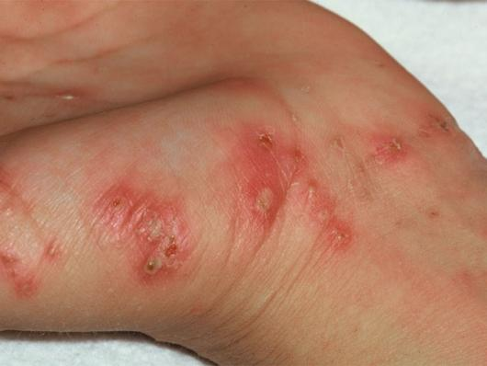
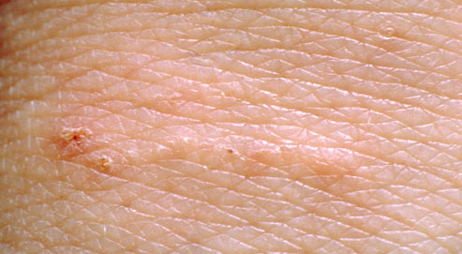
Biology and Behavior - Scabies Mites
Human scabies is an infestation of the skin by the human itch mite Sarcoptesscabiei var. hominis.
The female scabies mite burrowes into the upper layer of the skin where it lives and lays its eggs.

Slide 16

Spread by direct, prolonged,
skin-to-skin contact
Notes:
The scabies mite usually is spread by direct, prolonged, skin-to-skin contact with a person who has scabies. Humans are the source of infestation. Animals do not spread human scabies.

Slide 17
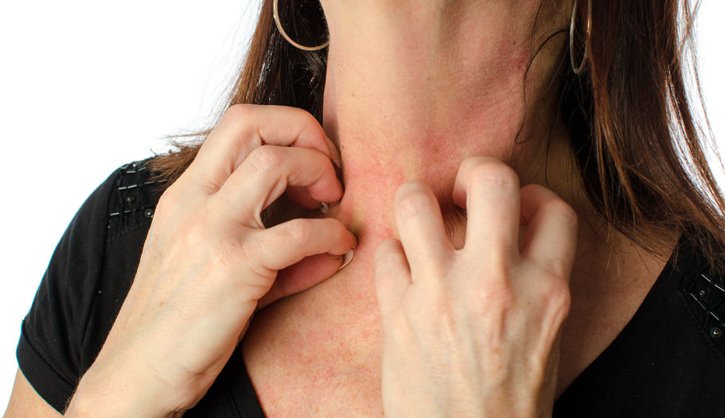
Intensely itching skin infection
Moderately contagious
Adults 1/3 millimeter long
Inactive below 20ºC (68ºF)
At 20ºC mites can persist for 2 weeks
Notes:
Females feed on the skin and fluids that are released from the damaged tissues
While in the burrows the females deposit fecal matter and lay eggs as they burrow

Slide 18
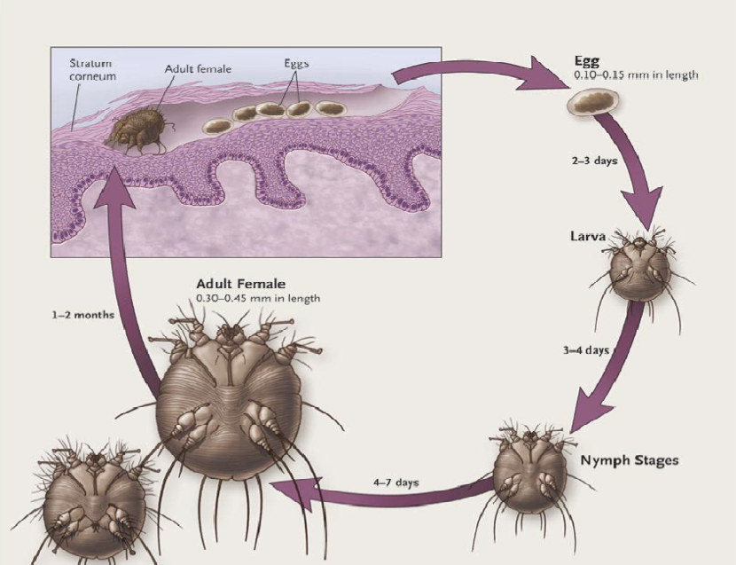
Infection occurs due to the direct transfer of a single fertilized female
Notes:
Scabies can spread rapidly under crowded conditions where close body contact is frequent.
Hospitals, childcare facilities, and schools are optimal locations for the spread of scabies.
Scabies mites are too small to be seen with the naked eye.
They do not fly or jump.
They can be killed by using treatments prescribed by a physician, and your body will naturally eliminate the mite remains over time.

Slide 19
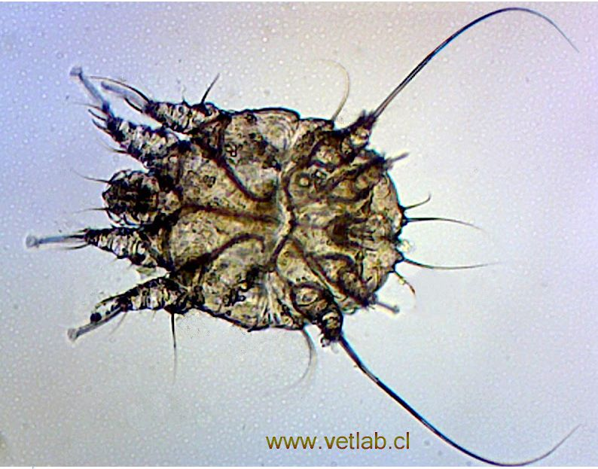
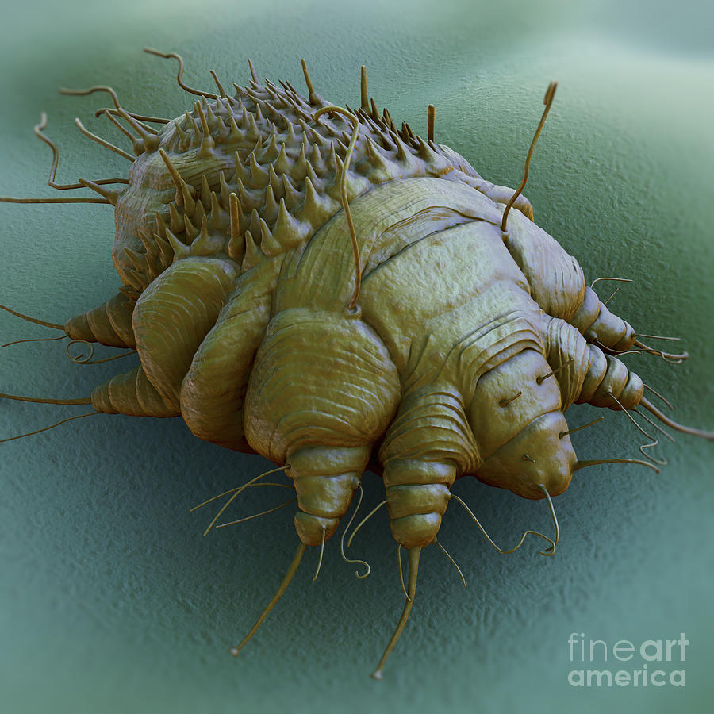
Life cycle 10-17 days
Remain viable for 3 days on inanimate objects (>22ºC, 72ºF)
Transmission via articles is possible, but unlikely

Slide 20
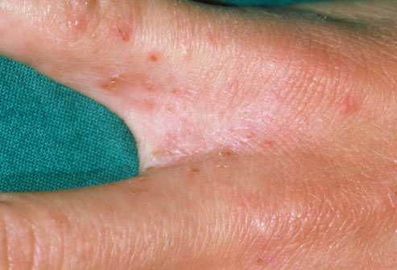
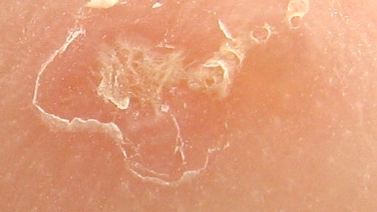
Burrows and malformed fingernails may or may not be evident
Burrows are often not seen but check in the webbing of fingers or on the inside of wrists

Slide 21

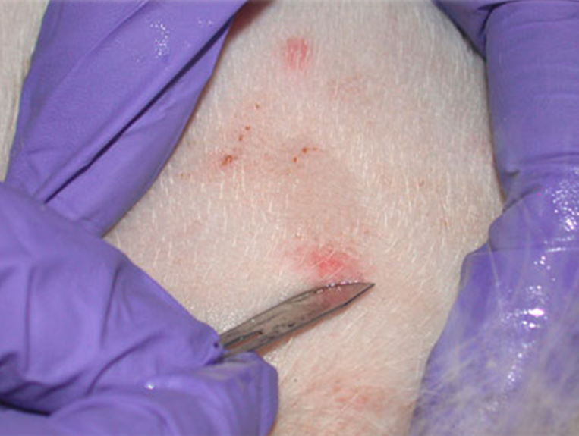
An affected host harbors only 10-15 adult mites - typical infestation
Skin scrapes are the only way to positively identify mites

Slide 22
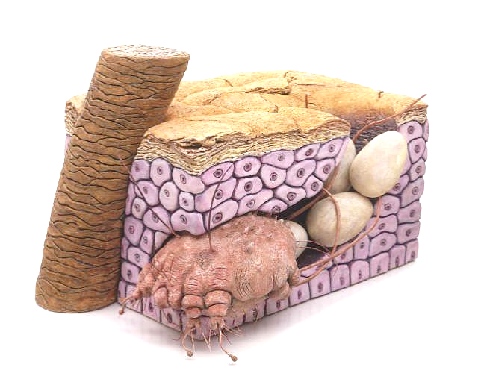
Hypersensitivity reaction to the mites, molts, eggs, or scybala occurs about 30 days after infestation
Notes:
Females feed on the skin and fluids that are released from the damaged tissues
While in the burrows the females deposit fecal matter and lay eggs as they burrow

Slide 23
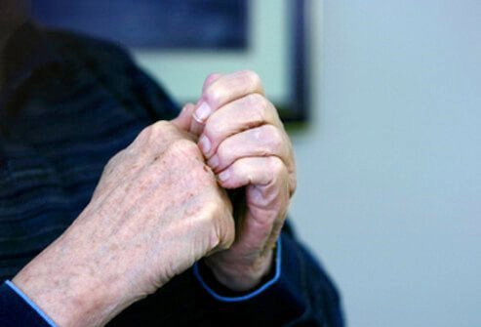
Disproportionately affects women and children
Secondary bacterial infection is common Staphylococcus aureus
Streptococci
Peptostreptococci

Slide 24
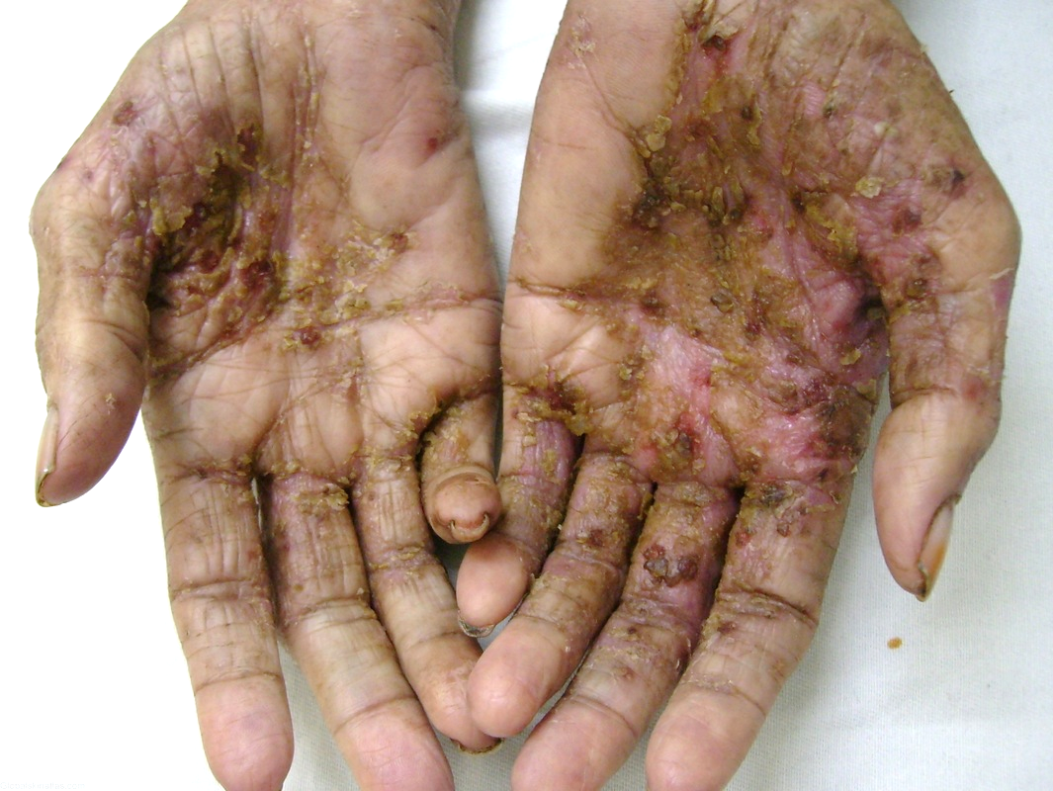
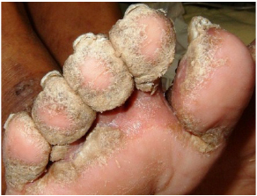
Immunocompromised prone to develop crusted scabies

Slide 25
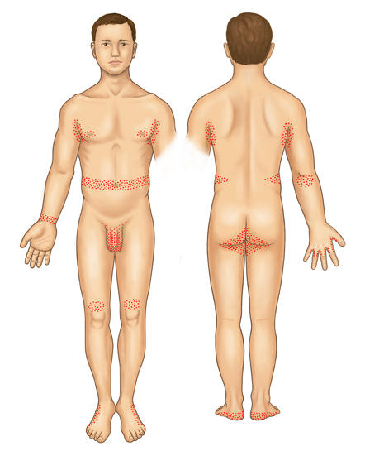
Usually below the neck - adults
Fingers, flexor surfaces
of the arms, wrists, axillae, and the
waistline
Umbilicus, nipples,
penis, and scrotum

Slide 26
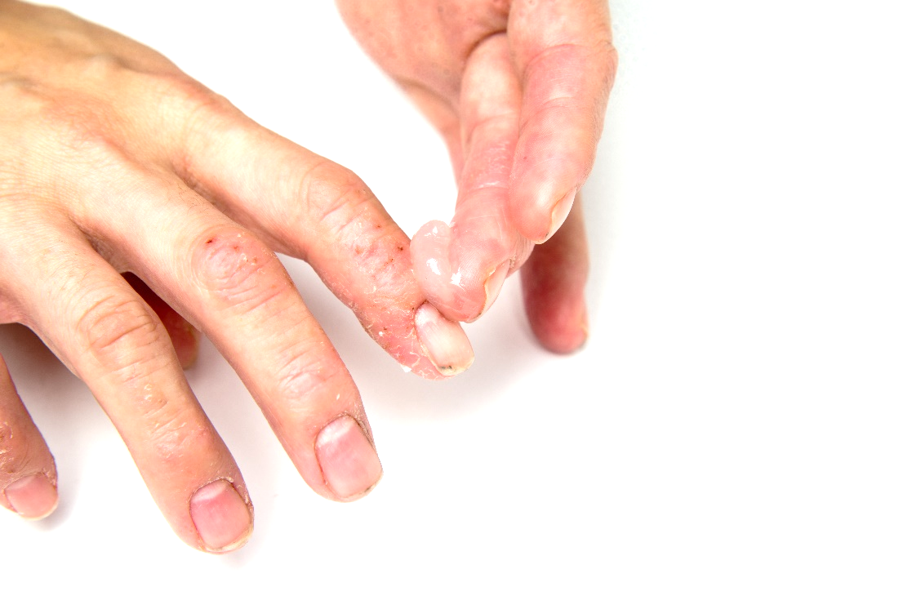
Infection eliminated using prescription treatments
Once treatment starts individuals are not infectious

Slide 27
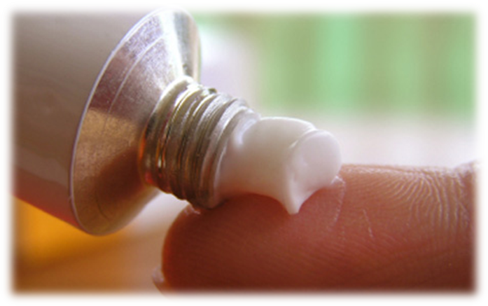
Treatments
Permethrin (e.g. Elimite)
Lotion applied over body from neck down
Left on for 8-12 hours, then rinsed off
Reapplication
1 week later
Clothes dryer
will kill mites

Slide 28
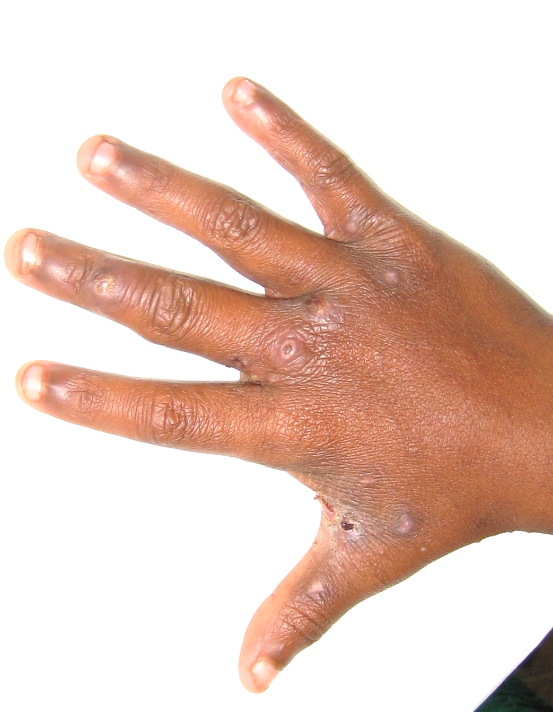
Treatments
Crotamiton (e.g. Eurax; Crotan) frequent treatment failure has been reported
Lindane lotion is NOT recommended

Slide 29
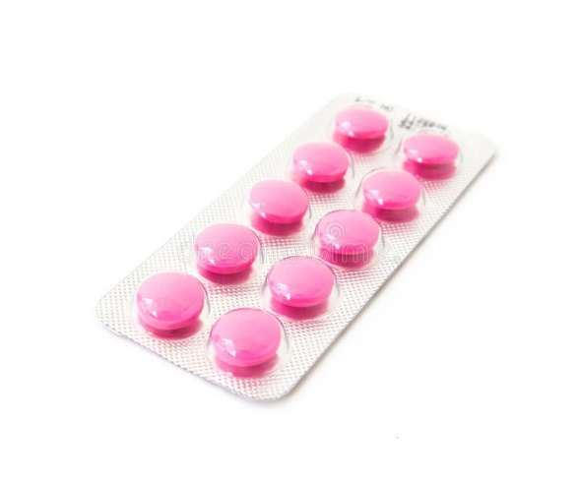
Relief from itching
Antihistamine diphenhydramine
Itching becomes worse after mites die

Slide 30
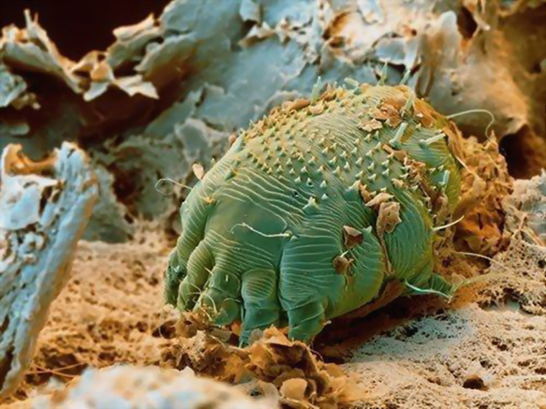
Inappropriate things
OTC pesticides applied to rooms or buses
Incorrect use of sterilants or disinfectants
applied to room
surfaces

Slide 31

Happy kids

Slide 32
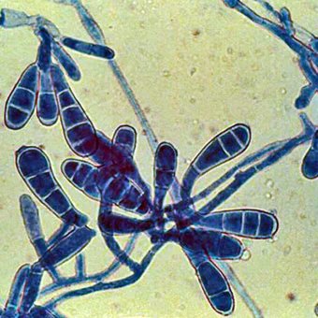
Itchy “bugs”
– Top 14
Bacterial conjunctivitis
Pertussis
Meningococcal meningitis
Hand, foot and mouth
Chickenpox
Measles
Mumps
Fifth disease
“Flu” Influenza
“Stomach flu” Norovirus
Scabies
Ringworm
Clostridium difficile
Methicillin-resistant Staphylococcus aureus (MRSA)
Impetigo (Strep/Staph)
Notes:
https://www.cdc.gov/vitalsigns/containing-unusual-resistance/
https://cdifffoundation.org/

Slide 33
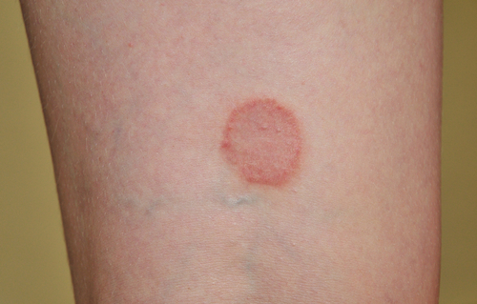
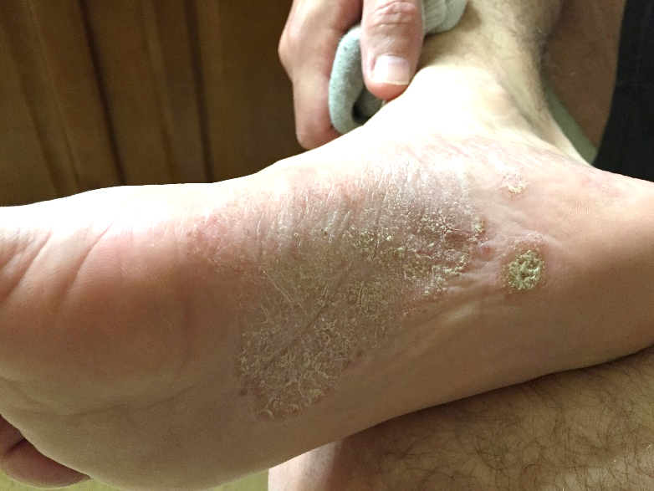
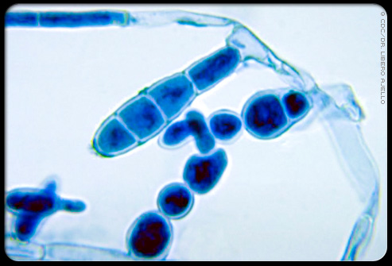
Ringworm - fungal skin infection
Dermatophytes – live off dead tissues (skin, hair, and nails)
Scaly, crusted rash
May itch

Slide 34
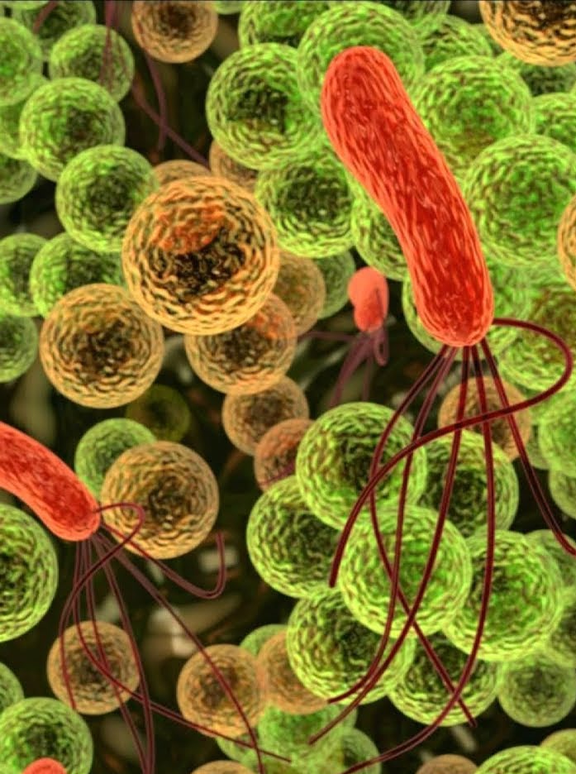
Microorganisms
“bugs”
Have only 2 jobs:
Survive
Reproduce

Slide 35


Moist areas
Tinea capitis
Tinea faciei
Tinea barbae
Tinea manus
Tinea
corporis
Children
Warm, moist
climates
Contagious
Contracted from an
infected person, animal, object, surfaces, or soil
Tinea cruris
Tinea unguium (nails)
Tinea pedis

Slide 36
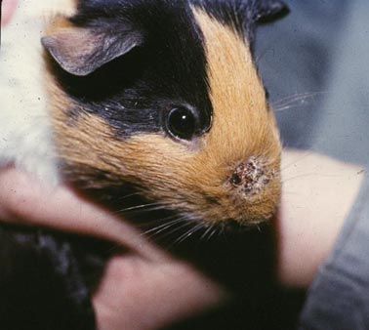
Transmitted from animals to humans
Class pets
Exclude feral cats
from classrooms

Slide 37
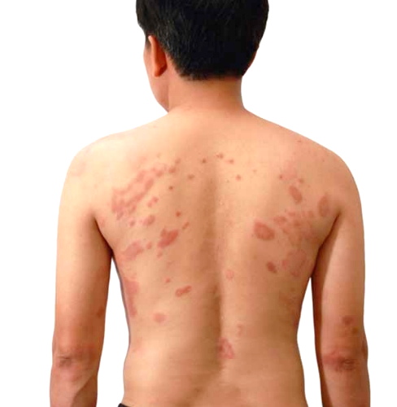



1. 1. 1.
Immunocompromised individuals should not be around ringworm

Slide 38

Clean hard surfaces with disinfectant
Carpeted areas vacuumed
Prescription antifungal medications before
returning to contact sports
Medications - topical
and/or oral

Slide 39

1. 1. 1.
Students should be referred to a doctor
Can persist on skin, hard surfaces, and on items such as clothing, towels, furniture and bedding
Spores can
survive >1year

Slide 40

Students should not participate in contact sports until treated
  Wear sandals or slides in showers and locker rooms
  Discourage sharing towels and clothing

Slide 41

1. 1. 1.
Campus animals
  Must be spayed/neutered, vaccinated and maintained in good health

Slide 42

More happy kids

Slide 43


Itchy “bugs”
– Top 14
Bacterial conjunctivitis
Pertussis
Meningococcal
meningitis
Hand, foot and mouth
Chickenpox
Measles
Mumps
Fifth disease
“Flu” Influenza
“Stomach flu” Norovirus
Scabies
Ringworm
Clostridium difficile
Methicillin-resistant Staphylococcus aureus (MRSA)
Impetigo (Strep/Staph)
Notes:
Impetigo (Step/Staph) Staphylococcus aureus & Streptococcus pyogenes
Bacterial conjunctivitis Step or Staph or lots of others
Pertussis Bordetella pertussis
Meningococcal meningitis Neisseria meningitidis
Hand, foot and mouth coxsackievirus
Chickenpox varicella zoster virus
Measles paramyxovirus
Mumps paramyxovirus
Fifth disease Parvovirus
“Flu” Influenza
“Stomach flu” Norovirus

Slide 44

1. 1. 1.
“Clean”
Cleaning removes pathogens and dirt
Sanitation reduces the number of disease-causing organisms to non-threatening levels
Disinfection destroys microorganisms, does not kill all pathogens
Sterilization kills
all disease-causing
pathogens

Slide 45

Sanitation for norovirus and influenza
Influenza virus survives on surfaces 2 - 8 hours
Norovirus survives on surfaces 2 weeks
Destroyed by heat (167-212°F), chemical germicides: chlorine, hydrogen peroxide, detergents, iodophors, alcohols
Concentration and length of
time

Slide 46

1. 1. 1.
Sanitation steps
Wash surfaces with general cleaner to remove dirt and organic matter first
Follow
label directions
Rinse with water
if instructed
EPA approved
disinfectants

Slide 47


1. 1. 1.
Clean hands constantly
Cover coughs and sneezes - droplets can move through the air 3-6 feet
Alcohol wipes and gels

Slide 48

1. 1. 1.
If using chlorine bleach
1 tablespoon of bleach to 1 quart (4 cups) of water, or ¼ cup of bleach to 1 gallon (16 cups) of water
  Apply solution to surface with a cloth
  Let it stand for 3 to 5 minutes
  Rinse with clean water

Slide 49

1. 1. 1.
Wipes used on items that are touched often
Door handles
Phones
Computer keyboards

Slide 50

1. 1. 1.
Tissues thrown in trash or bagged
Persons cleaning classrooms
or emptying trash – wear gloves, then wash hands

Slide 51

1. 1. 1.
Norovirus is leading cause of
food-borne illness
Sick staff or those caring for others who are sick should not prepare food
Infected food workers cause
70% of reported norovirus
outbreaks
Very contagious

Slide 52

1. 1. 1.
Hand washing is critically important
Found in vomit or stool even before a person is sick, and for 2-3 weeks after symptoms abate
Alcohol-based hand
sanitizers used in
addition to
hand washing

Slide 53

Impetigo
Highly contagious
Caused by Staphylococcus aureus and/or Streptococcus pyogenes
Red sores on the face, around nose, mouth, hands and feet
Sores burst and develop
honey-colored crusts
Itchy

Slide 54

MRSA Methicillin-resistant Staphylococcus aureus
Spread through cuts, abrasions and skin-to-skin contact
Contaminated
surfaces
Begins as
painful/itchy
boil

Slide 55

Managing methicillin-resistant Staphylococcus aureus
Survives 7 days - 7 months on dry surfaces
Exclude students with wound drainage from sports
Enforce hand hygiene
Cover sores

Slide 56

Clostridium difficile (C-diff)
After antibiotic therapy
Diarrhea
Pseudomembranous and toxic colitis
Fever
Abdominal pain
Cramping
Nausea and loss
of appetite

Slide 57

Managing Clostridium difficile
Spores highly resistant to cleaning agents
Survive for 5 months on dry surfaces
Handwashing
Killed by
chlorine
bleach
Isolate infected
individuals

Slide 58

>23,000 Americans die annually from antibiotic resistant infections
Resistance occurs when antibiotics are used:
Appropriately
Food and water (waste)
Our environment
Inappropriately (e.g., vial infection)

Slide 59

Resistant infections
Antibiotic
Plasmid
Impermeable
protein
Ribosomes
Inactivation
Added phosphate group
reduces ability to bind
Modified
target site
Pumping out
Increasing active efflux

Slide 60


CDC: washing hands with soap and water is effective
Increasing incidence of “super bugs”
Avoid triclosan – absorbed through the skin and bio-accumulates, linked to liver damage and resistant bacteria
1 (800) 858-7378
http://npic.orst.edu/

Slide 61

Integrated Pest Management (IPM)
Effective communication, education and cooperative between school personnel:
    School nurses
    IPM Coordinator
    Facility users
    Custodial
    Food service
    Landscape and
    grounds maintenance
    Teachers
    Administrators

Slide 62



Contact:
Shujuan (Lucy) Li, Ph.D.
Assistant in Extension
Public Health IPM
University of Arizona
Maricopa Agricultural Center
37860 W. Smith-Enke Road
Maricopa, AZ 85138-3010
lucyli@email.arizona.edu
Contact:
Shujuan (Lucy) Li, Ph.D.
Assistant in Extension
Public Health IPM
University of Arizona
Maricopa Agricultural Center
37860 W. Smith-Enke Road
Maricopa, AZ 85138-3010

